Slide 1
May 10, 2019 Board of directors meeting

Slide 2
Consent Agenda
Approval of minutes from previous meeting

Slide 3
Transition Update

Slide 4
Transitioning 2019 Contracts and Grants
 | Jan | Feb | Mar | Apr | May | Jun | Jul | Aug | Sep | Oct | Nov | Dec
ORH
Common Ground
Lift
GRHF - Steps
HRSA - Opioid
FLPPS - Opioid
FLPPS Navigator
FLPPS CBO Ref.
FLPPS Comm Nav.
FLPPS NOCN Leader
Common Ground assisting ($17k) – First report submitted on 4/30/19
Mtg w/ Albert on 5/14 to review work for 2019-2020 contract
2nd Year Contract Signed; Budget Modifications in Process
Renewal (Phase IV) submitted to GRHF – Prospects are good
Hillary still on board with coming to S2AY
Met with C. Tegas – focus on keeping work going
S2AY not renewing (Ardent is likely partner with HSD)
S2AY not renewing (Ardent is likely partner with HSD)
S2AY not renewing. Unsure if FLPPS will continue this program.
FLPPS determines NOCN leader. Have extended Andrea through 6/30, but not as S2AY representative. S2AY ED attending meetings.
HSD Lead S2AY Lead Renewal End of Grant

Slide 5
Transitioning 2019 Contracts and Grants
 | Jan | Feb | Mar | Apr | May | Jun | Jul | Aug | Sep | Oct | Nov | Dec
UW CHA*
CHSC (BOCES)
Radon
No update
Budget mod for travel/material for K. Carpenter. HSD actively trying to maintain grant after September.
Grant will run through 6/30/20 (need to update contract with Schuyler County)
* United Way (UW) also had a Lead Grant. $10,000 for Steuben and Chemung for improving the knowledge of lead exposure of workers who provide services to families directly in the home. Focusing training on staff of CIDS, Pro Action and other agencies. An action plan needs to be developed here, but grant is not likely to be extended.
HSD Lead S2AY Lead Renewal End of Grant

Slide 6
Administrative Transition
Directors & Officers Coverage In Place (Effective 3/22/19 – 3/22/20)
Workers Compensation Audit on 5/15
Online Time Tracking Tool Rolled Out 4/24
Targeting 2018 Audit with EFPR (current auditor) in June/July
Financial Reports Updated Regularly

Slide 7
Financial Report

Slide 8
Notable Revenue Variances for Q1 ($196,887)
HRSA budgeted $33,667 per month through September 2019. HSD is Administering this grant and has not invoiced anything for this grant. This accounts for $101,000 of the variance.
LIFT budgeted at $21,850 per month. Due to restricted funds on the original contract, and waiting for Budget Modifications to go through. We’ve been suppressed to only billing $39,336 through March. $26,286.83 in January, $5,660.42 in February and $7,388.77 in March. This accounts for $26,213 of the variance.
ORH budgeted at $14,510.67 per month. Quarterly invoicing posted in April for $34,296.87. This accounts for $43,532.01 of the variance, timing difference. HSD preforming the CHP/CHA for only 1 month accounts for the billing variance.
GRHF S. Seneca -STEPS - $14,125 budgeted per month. This $195,000 grant was Fully accounted for in July 2018 in the Revenues category. At this point we show actual costs but no revenues (until July 2019). This accounts for $42,375 of the variance.
County Membership- Inversely-This program was budgeted with some funds coming in June, but has been fully invoiced. This accounts for ($17,000) in Variance.
Total Revenue Variance Notes total $196,120.

Slide 9
Notable Expense Variances for Q1 ($124,979)
Salaries/wages/fringe – 2nd Program Director was not been hired and delay in hiring Jennifer Hatch. This accounts for $85,735 of the variance.
Mileage/Travel/Supplies- Also relates to lower headcount. Variance of ~ $7,000
Contractual Services and Grants
HSD terminated services for CHP/CHA account, this accounts for a variance of $6,000.
HRSA -Peer Advocated with Partner Age was budgeted at $10,111 per month for HRSA. No activity has happened, variance of $30,333.
National Wellness Inversely budgeted at $1,525 per month, but paid $9,150 in January for training for Year 1 expenses. Variance of ($4,575).
Total Expense Variance Notes total $124,493.

Slide 10
S2AY Rural Health Network Board of Directors
Jackie Lyttle
Executive Director
2019 S2AY DRAFT Org Structure
Theresa Lahr
Project Coordinator - STEPS
Michele Foster
Program Director
Hillary Anderson
Opioid/Substance Use
Project Manager
Kim Arnold
Quality Improvement Coordinator
TBD*
Program Manager/Director Compliance Officer
Jennifer Hatch
LIFT Program Manager
Starting 3/4/19
Gabe Telarico
Community Business Mentor
Jesse Dow
Program Administrator
Kristin Parry
Outreach/Media Specialist
Sara Schraeder
LIFT Program Coordinator
Betty Brigham
Immunization Specialist
Lynne Doyle
Community Engagement Specialist
Full Time
Part Time
Future (7/1)
* Will be based on skill set of candidate

Slide 11
Approvals Needed
Approval to sign Common Ground contract for $17,000 to support Community Health Assessment work
Retroactive approval needed
Will be reimbursed through ORH Grant

Slide 12
Approvals Needed

Slide 13
Cultural Competency/Health Literacy
Review CCHL progress and plans
Value & Importance of CCHL in S2AY Work

Slide 14
Culture is…

Slide 15
Characteristics of Cultures
All cultures have at least five characteristics in common:
1
Culture is Learned
2
Culture is Based on Symbols
3
Culture is Shared
4
Culture is Patterned or Integrated
5
Culture is Usually Adaptive

Slide 16
Cultural Values
Culture Shapes our Identities and Influences Our Lens
Values and Beliefs
Ideas About Respect and Honor
Customs, Music and Language
Family and Community Rules of Proper Behavior
Taboos and Sanctions
And More…
What is considered normal or abnormal
What people think should be prevented or punished
What should be accepted, promoted and rewarded
What is considered respectful, beautiful and intelligent
How people interpret reality

Slide 17
Five Elements of Cultural Competence
Individual Level
1
Acknowledge Cultural Differences
2
Understand Your Own Culture
3
Engage in Self-Assessment
4
Acquire Cultural Knowledge and Skills
5
View Behavior with a Cultural Context
Source: Cross, Bazron, Dennis and Isaacs, 1989

Slide 18
Thinking About Our Community Members
Who lives here?
How is community defined?
How do people see their future?
What issues and problems are people facing?
What are they doing about them?
What are their strengths?
How do things get done?
How do decisions get made?
Who are the gatekeepers?
Who are the bridge builders?
What’s my role?
How am I perceived?

Slide 19
Conclusions
Cultural competence, the ability to interact effectively with people of different cultures, helps to ensure the needs of all community members are addressed.
“Culture” is a term that goes beyond just race or ethnicity. It can also refer to such characteristics as age, gender, sexual orientation, disability, religion, income level, education, geographical location, or profession.
Cultural competence means to be respectful and responsive to the beliefs and practices—and cultural and linguistic needs—of diverse population groups.
Developing cultural competence is also an evolving, dynamic process that takes time and occurs along a continuum.
Cultural competent organizations invests in building a workforce that is culturally aware, measures cultural competence in all inner-workings, and promotes cultural diversity and inclusion.

Slide 20
What is Health Literacy?
Health literacy is how people obtain, process, and understand their basic health information and services needed to make appropriate health decisions.
Healthy People 2020
Notes:
Health literacy is dependent on both an individual, and their providers’ abilities:
Communication skills
Knowledge of health topics
Culture
Demands of the healthcare and public health systems
Demands of the situation

Slide 21
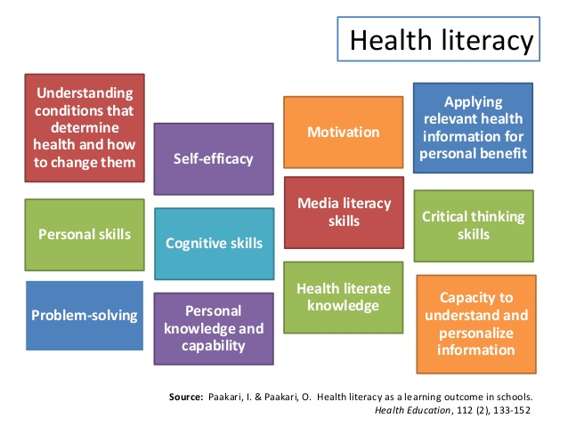
Attributes of Health Literacy
Source: Paakari, I. & Paakari, O. Health Literacy as a Learning Outcome in Schools.
Notes:
Health literacy isn’t a simple set of abilities that allow a person to understand their health and healthcare. It is a complex set of cognitive processes, and if even one or two are lacking, it has the potential to create a life-threatening situation. Providers cannot be responsible to ensure that every patient is proficient in each of the above listed areas. This is where we need to work together as a service delivery system, rather than operating in silos.
If a provider realizes that a patient is not proficient in one of these areas, there are community based resources they can make referrals to. Agencies that provide support to people with developmental disabilities, mental health diagnoses, substance abuse concerns, as well as people who struggle with medical concerns exist in every community in New York State. New York is one of the service-richest states in our country. Healthcare systems and smaller medical offices should be creating networks of care with pharmacies, specialists, clinics and community-based service organizations in their area to create a more holistic approach to their patient’s healthcare.

Slide 22
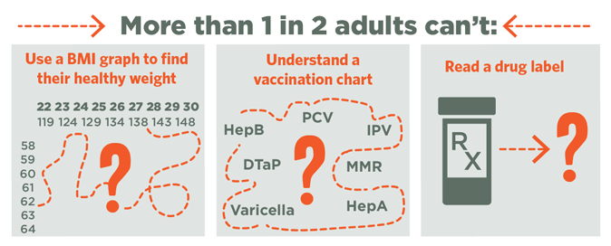
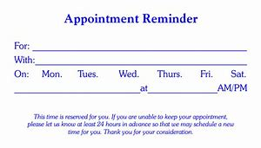
Challenges of Health Literacy
Participant in health screenings
Read an appointment card
Mammogram
BP Test
Eye Exam
Complete an accurate Health History Form
Blood Glucose Test
Notes:
Correlate each square to an issue that a provider may face due to their patient’s low health literacy:
Use a BMI graph to find their healthy weight- Patients with low health literacy may have less knowledge of disease and self-care
Understand a vaccination chart- Patient with low health literacy may not participate in preventative health programs and/or have less self-management skills
Participate in health screening- Patients with low health literacy may have lower use of health screenings
Lower medication compliance rates- Patients with low health literacy may not take their medications according to the instructions or may not fill or seek refills when necessary
Read an appointment card- Patients with low health literacy may often “No Show” or be late for appointments
Ask audience for additional examples of health literacy challenges that they face as a result of their patients’ low health literacy.

Slide 23
Building a Health Literate Environment
Access to Care
Health Information Technology
Navigation
Helpful Staff or Volunteers
Clear Directions
Physical Environment
Entrance Clear and Visible Signage
Facility Maps
User Friendly Phone System
Eliminates Complex Forms
Health Education Materials
Language Assistance Notifications
Information Desk
Information Kiosks
Ease of Referrals
Decrease Stigma
Enhances privacy, comfort and patient control
Source: Partners for Action: Healthcare Facility Literacy-Friendly
Notes:
The organization uses techniques to make it easy for people to find information in facilities, such as health departments, clinics, and social service agencies, and on Web sites and other communication channels.
Help finding the way in facilities can mean providing clear signs, directions, forms, and helpful staff who provide information in plain language. Best practices in Web design and social media communication help the organization make its electronic materials, messages, and systems, such as patient portals or online databases, easy for people to find, understand, and use. If the organization provides telephone-based information or services, such as appointment scheduling or toll-free information lines, it can make sure staff use plain language when talking with the public.

Slide 24
GRHF - STEPS
engage residents with our resident driven and designed community health improvement plan items and help residents and community partners get others engaged;
creative STEPS approach to continue to bring new people to the STEPS project, promote collective effort with innovative ideas;
function as a catalyst, engage residents along with partner organizations and institutions focusing on project sustainability.
See Attachment

Slide 25
Health Services Advisory Board
Topics to Discuss?

Slide 26
Other Business
Next Meeting: July 12, 2019 at 9am in Yates County

